Slide 1
Lecture 8: Spatio-temporal models

Slide 2
Discussion topics:
Temporal scale
Infill vs. sprawl asymptotics
Separable spatio-temporal models
Indices of spatio-temporal variation

Slide 3
Temporal scale
Daily
Light and visual predation, temperature
Monthly
Lunar cycle for spawning and nighttime light
Seasonal
Solar cycles
Interannual
Predator cycles (cohort resonance)
Decadal
Oceanographic forcing (PDO)

Slide 4
Infill asymptotics:
Expected performance for (nearly) infinite sample density within a fixed spatial area
Not good for estimating spatial scales (because never has new data about other areas)
Sprawl asymptotics
Expected performance for a (nearly) infinite domain, with a fixed density of samples per area
Not good at estimating variables within a fixed area

Slide 5
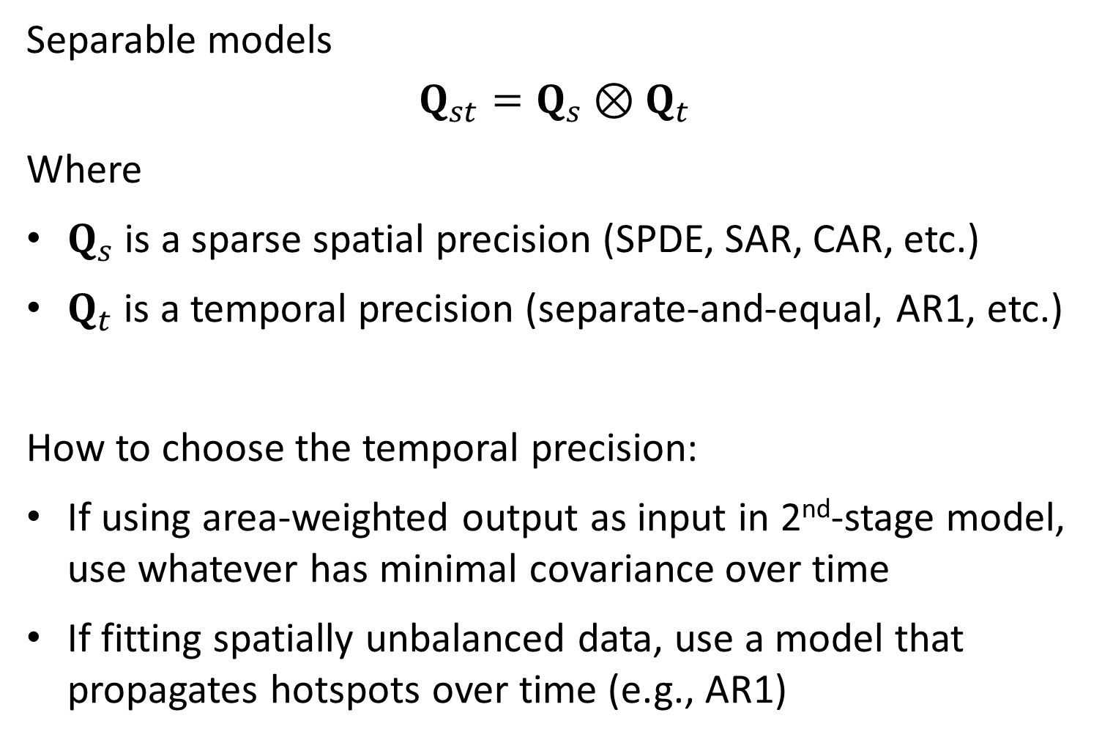
Separable models
$$Q_{st}=Q_{s}⊗Q_{t}$$
Where
$Q_{s}$ is a sparse spatial precision (SPDE, SAR, CAR, etc.)
$Q_{t}$ is a temporal precision (separate-and-equal, AR1, etc.)
How to choose the temporal precision:
If using area-weighted output as input in 2nd-stage model, use whatever has minimal covariance over time
If fitting spatially unbalanced data, use a model that propagates hotspots over time (e.g., AR1)

Slide 6
Indices for spatio-temporal variation
Univariate
Multivariate
Metric | Use
Total abundance/biomass | Status and trends Fitted in 2nd stage (population-dynamics) model
Center of distribution | Measure shifts in distribution
Average local density | Measure density dependence
Effective area occupied | Measure range expansion/contraction
Metric | Use
Species overlap | Measure strength of interaction

